Slide 1


A wind tunnel for kids…
Status Update
February 2, 2012

Slide 2
Activities this week
Hardware work
Arduino prototype development (Utah)
Hall Effect & Motor control (Tennessee)
Android development
Physical Tunnel Interface
Improved workflow
Windows build environment

Slide 3

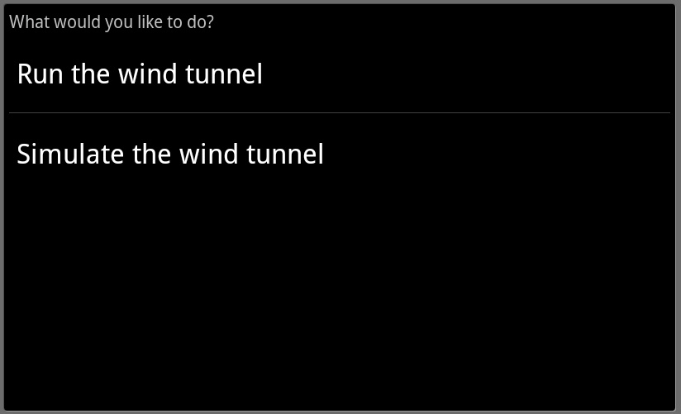
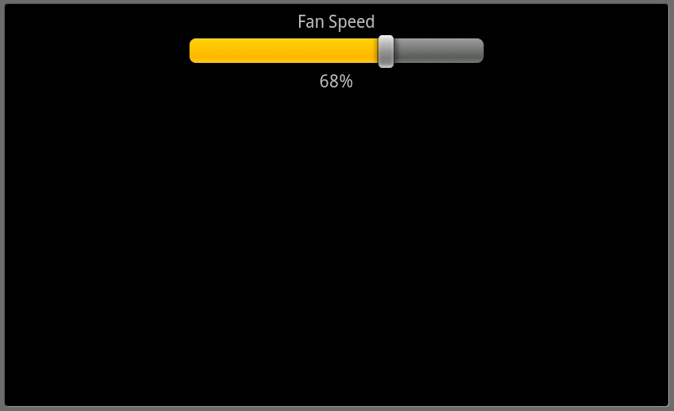
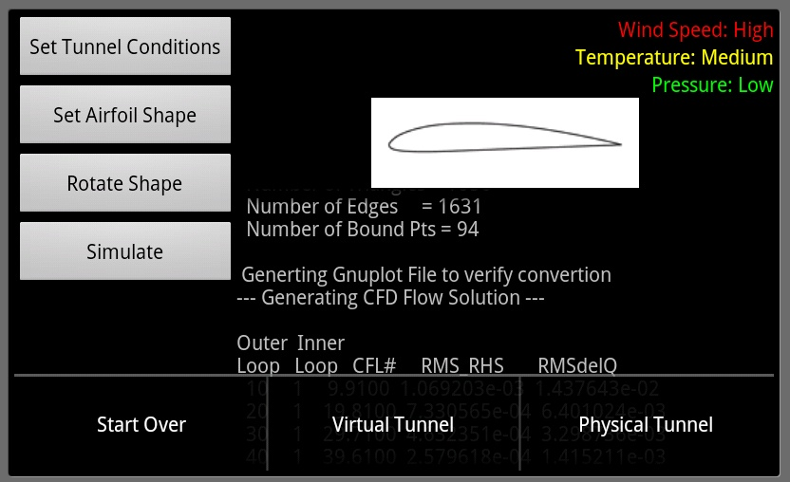
Android Screenshots
Splash Screen
Choose Activity
Tunnel Control
Options Menu

Slide 4
Baseline Documentation Metrics
Metric | Value | Notes
# Developer Documents | 5 | SoW, SDP, SRS, SDD, Fall FQT
# Administrator Documents | 0
# Pages | 47
# Status Presentation Slides | 84

Slide 5
Baseline Code Metrics
Metric | Value | Notes
SLOC (Physical) | 8825 | Switched to more robust SLOC counting tool
SLOC (Logical) | 6499
# Source Files | 96 | File types included: .h, .cpp, .java, .xml, .pde

Slide 6
Baseline Hardware Metrics
Metric | Value | Notes
# Sensors Prototyped | 3 | Temperature, Humidity, Hall Effect
# Control Elements Prototyped | 1 | Motor Control
# Sensors Integrated | 1 | Hall Effect
# Control Elements Integrated | 1 | Motor Control

Slide 7
Motor Control
Motor control & Hall effect work in tunnel
Next step: integrate with arduino
http://youtu.be/T9Ffd03z_J4

Slide 8


Follow us on Twitter… 7 followers – 47 tweets
@TunnelK
Notes:
Initial social network of choice…

